Slide 1
Project 3 Checklist

Slide 2
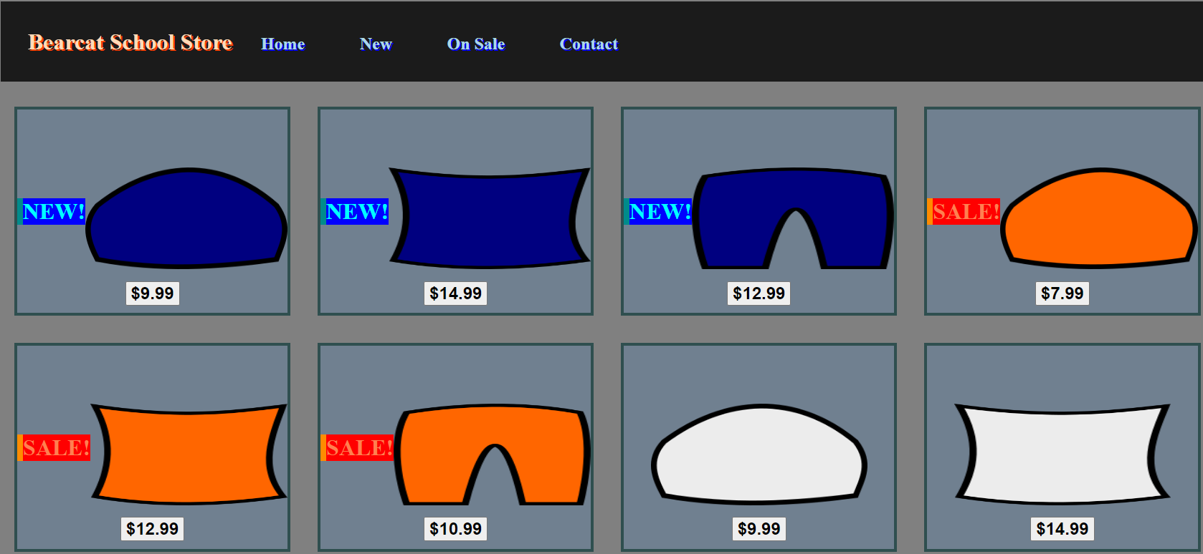
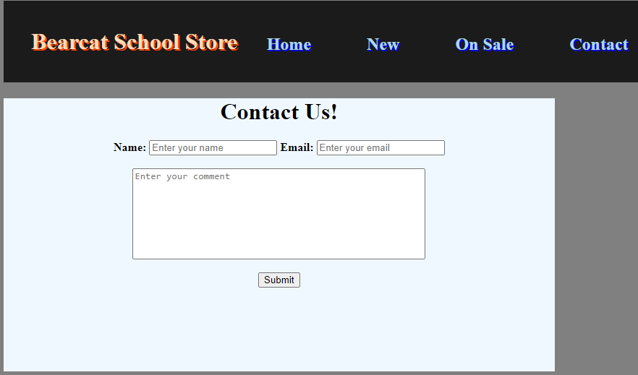
Project Overview

Slide 3
Day 1: Create Images For Products
Pillow
Pants
Beanie

Slide 4
Day 2: Create An Item Container
New Item
Sale Item
Regular Item

Slide 5
Day 3: Create The “All Items” Display
Combine New, Sale, and Regular Items in an organized manner

Slide 6
Day 4: Create the Header
A tab for each page that navigates to that page upon clicking

Slide 7
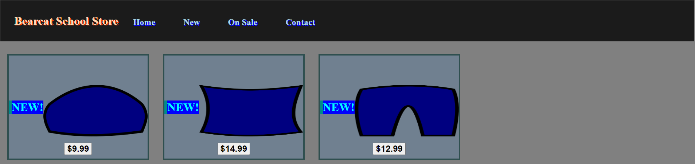
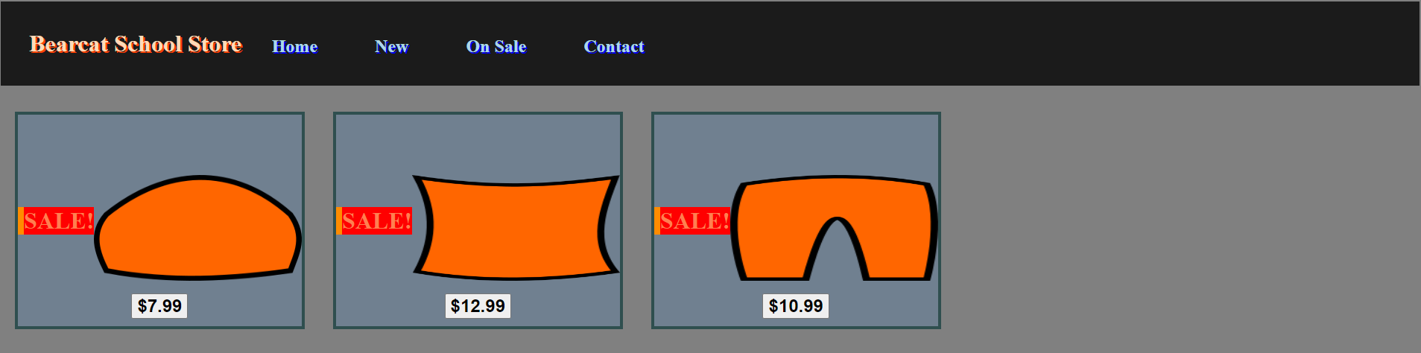
Day 5: Create the “New” and “Sale” Pages

Slide 8

Day 6: Create The Contact Form

Slide 9
Day 7: Catchup + Go The Extra Mile!
Add a product page that contains information for each product that is linked to the image of the product on the products page(s)
Create an item container for out-of-stock items
Create a form for users to create accounts and log in
Create a form for store owners to add new products
Review code to ensure it is easy to read and well-organized

